Slide 1
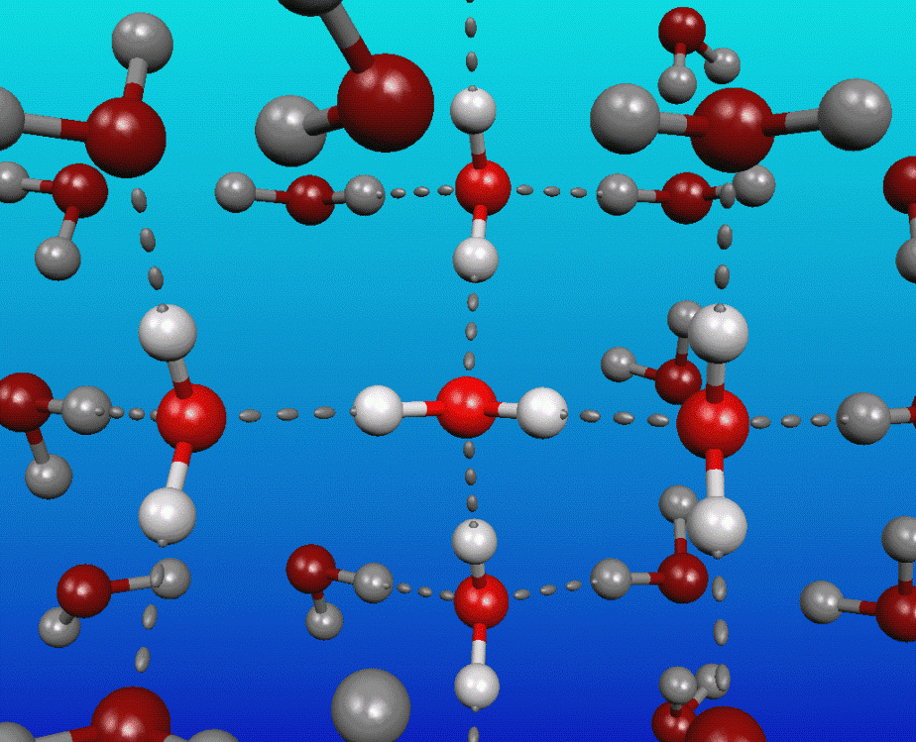

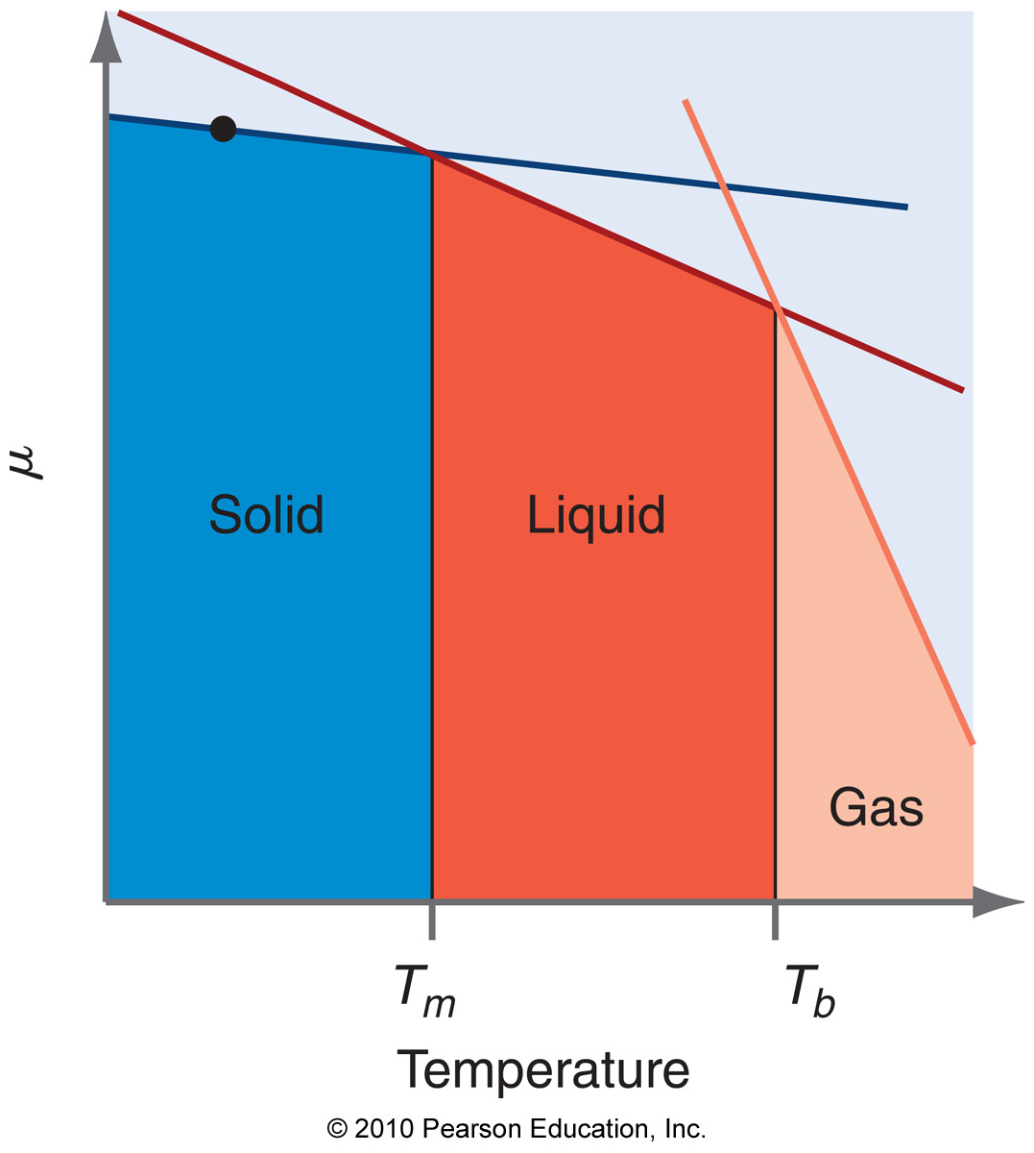
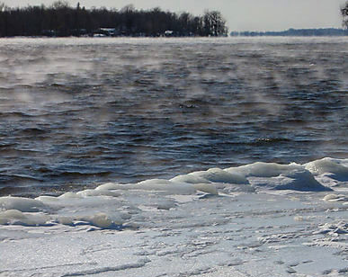
CHEM 450/450G
Dr. M. J. Nee
Lecture II-3
Phase Changes
Plan for Today:
Chemical potential and phase change
P-T diagrams
The Phase Rule
The Clapeyron Equation

Slide 2
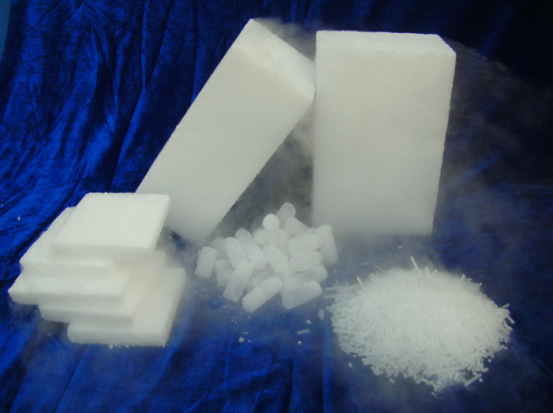
Solids and Liquids in equilibrium
Pressure dependence of G for solids and liquids is very small...
But equilibrium involving multiple phases is still:
for
SO: K_{P} involves only the gases, but ΔG_{R} involves all species

Slide 3
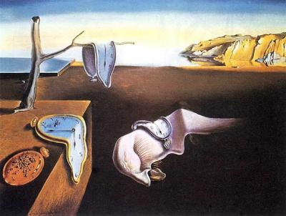
Phase Change
Begin to consider what happens at a molecular level to understand how the bulk behaves.
Have these clocks undergone phase change? What about melting chocolate?

Slide 4
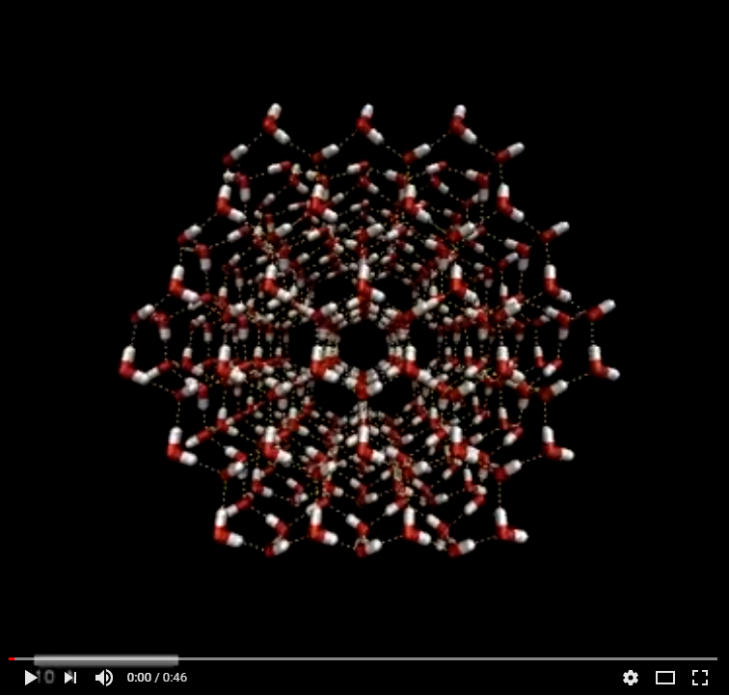
Phase change: a molecular picture
States of matter are dictated by intermolecular forces
Solids have settled into the “minima” in potential energy, not enough KE to escape.

Slide 5
Phase change and μ
Phase change is a chemical reaction. It has multiple components, so we must use μ
Many phases are often present together. Are they all in eqm?
We recognize phase equilibrium based on chemical potential.

Slide 6
Plots of μ v. T
As T increases, the phase with the lowest chemical potential changes. All have the same general form:

Slide 7
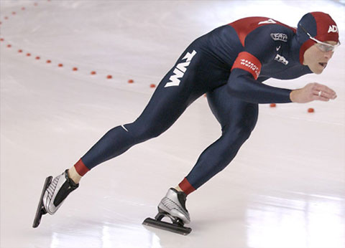
Changes in BP, FP
Based on these plots (and on some math), we can show that an increase in pressure causes:
Boiling point elevation
Freezing point depression for
or
Freezing point elevation for

Slide 8
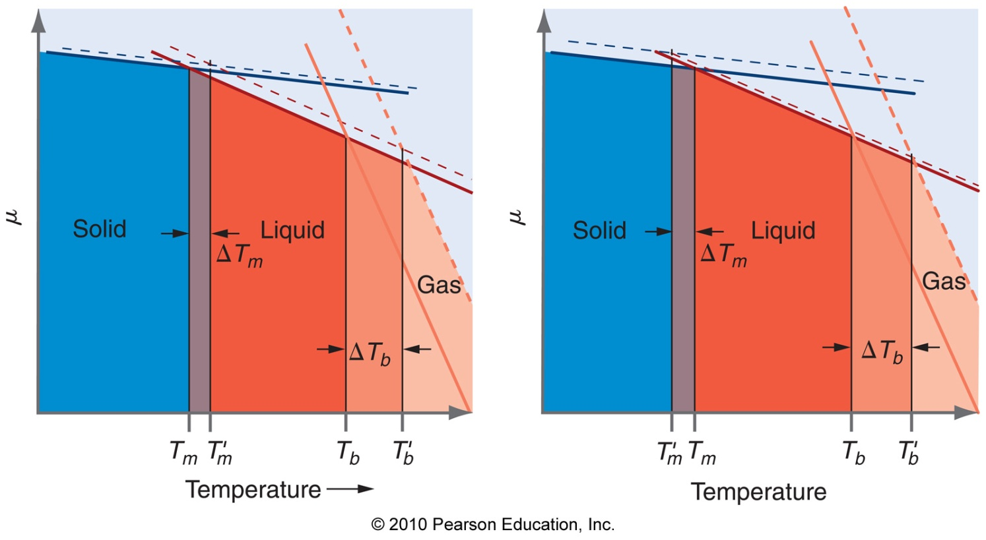
Dependence on T and P
How do plots from before change with P?
P₁
--- P₂ > P₁
T_{m,2} > T_{m,1}
T_{m,2} < T_{m,1}

Slide 9
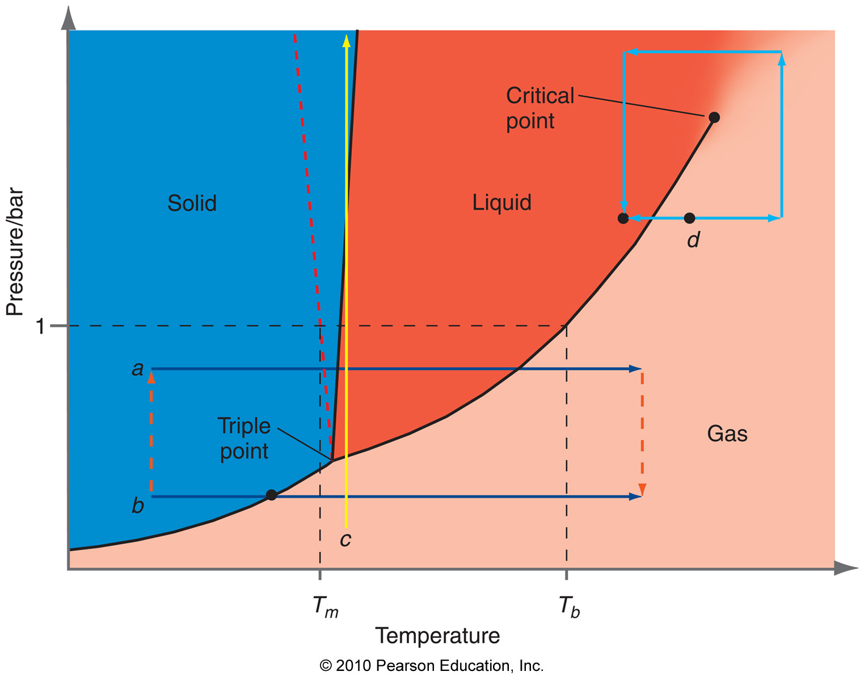
Pressure-Temperature Phase Diagrams

Slide 10

Important points on P-T diagrams
Co-existance curves: lines where two phases are in equilibrium.
Triple point: Single point in P-T space where three phases coexist.
Critical point: P, T, beyond which there is no difference in V_{m} of the liquid and the gas (supercritical fluid).

Slide 11
Chemical potential explains P-T diagram
At equilibrium:
At triple point:
At a different pressure, use the different μ-T diagram

Slide 12
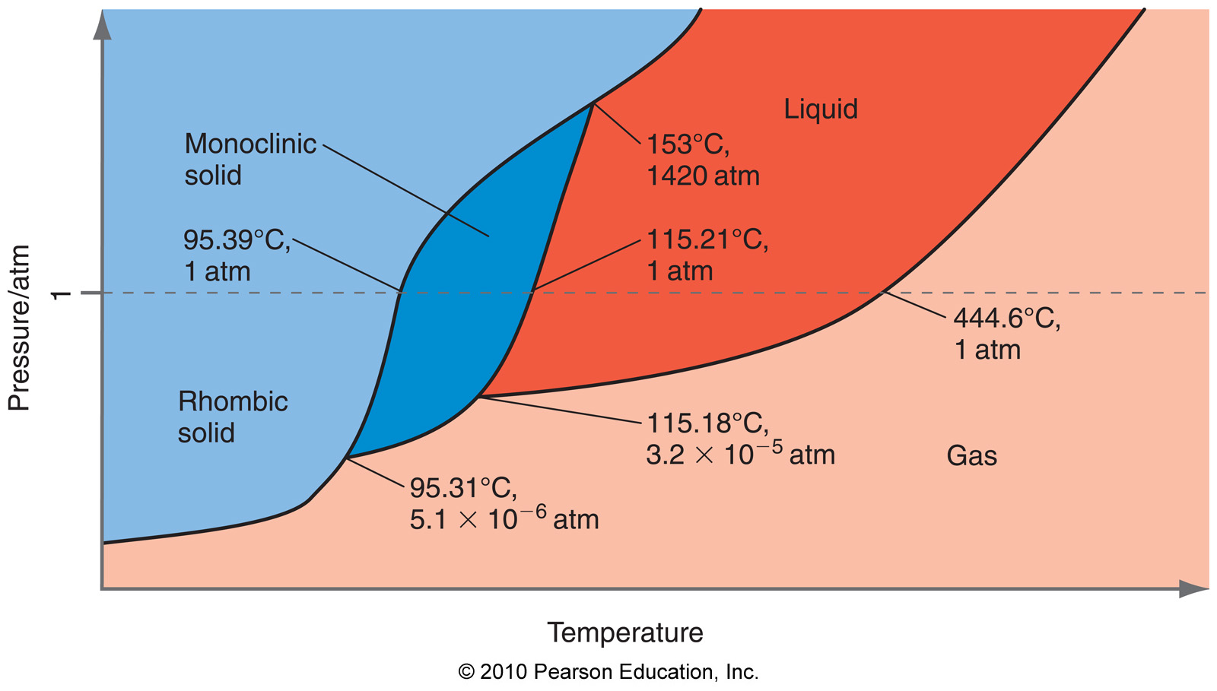
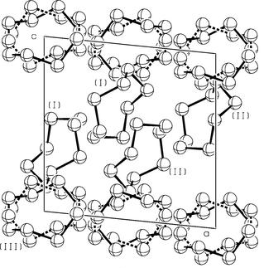
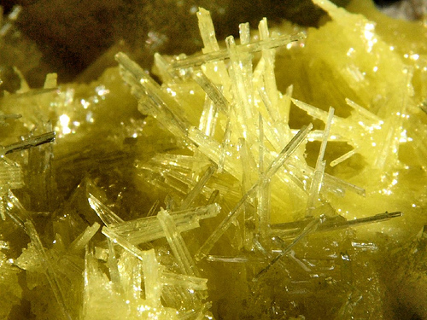
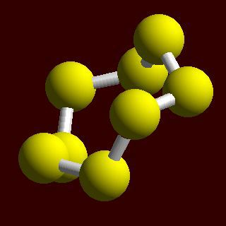
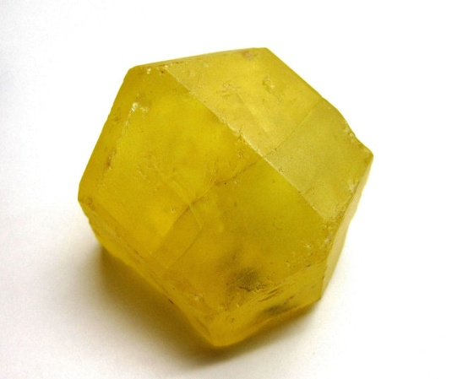
More complicated systems: multiple solids
Phase diagram of sulfur has several solids because atoms can arrange in different ways

Slide 13
The Phase Rule
For a single component system (one pure compound):
Where F = independent degrees of freedom, and p = number of phases at that point.
For c components:

Slide 14
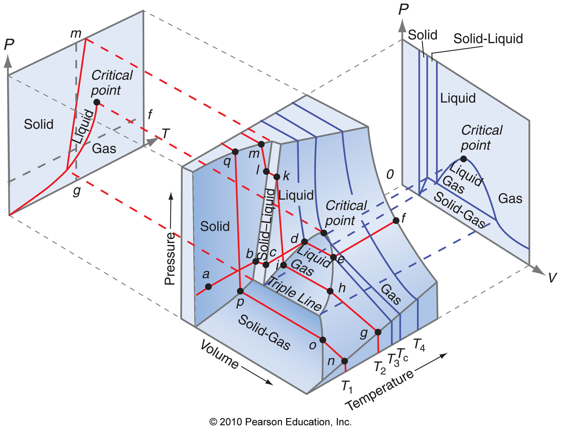
P-T diagrams are just a slice of reality

Slide 15
The Clapeyron Equation
Math behind phase diagrams involves determining the slope of P wrt T.
Sign of slope is correlated to density change:
increase P, increase density
increase P, decrease density

Slide 16
The Claussius-Clapeyron Equation
For the liquid-vapor co-existance line, ΔV ≈ V_{gas}:
Thus, we are able to obtain ΔH_{vap} from P-T diagram

Slide 17
Reading: Finish up Chapter 8. We will also start Chapter 9 next time (solutions), but only at a rudimentary level.
HW 5 is due 10/15.

